Slide 1


AI-Driven NLP Chatbot for Skin Disease
Diagnosis and Medication recommendations
Professor: Muhammed Ali Yousuf
PRESENTERS
Akshay Reddy Gone (AM60898)
Sai Sreeja Allepu (YD50976)
Yeswanth Reddy Chereddy (RD76099)

Slide 2
CONTENTS
INTRODUCTION
PROBLEM STATEMENT
OBJECTIVE
BUSINESS PERSPECTIVE
DESCRIPTION OF THE DATASET
METHODOLOGY
IMPLEMENTATION
KEY FINDINGS
CONCLUSION
REFERENCES

Slide 3
INTRODUCTION
Our project is to develop an AI-driven chatbot which uses image recognition (using CNN) and natural language processing (NLP) to diagnose skin diseases and concerns which may be major or minor and recommend personalized medications. We made sure that users can interact with the chatbot by uploading images of skin conditions and querying for treatment advice, creating a seamless and accessible diagnostic tool making it as simple as a google search but more efficient way!

Slide 4




PROBLEM STATEMENT
Limited access to dermatologists which lead to delayed diagnosis and treatment of skin conditions.
Costly and time-consuming dermatological consultations discourage patients from seeking timely treatment.
Patients often rely on unverified online sources, leading to misdiagnosis
due to inaccurate treatment recommendations.

Slide 5
OBJECTIVE
Our main objective of this project is to create an AI powered chatbot that can
Diagnose skin issues and suggest suitable medications
Doesn’t cost money to the user
Save time and energy of the user
Have user friendly interaction with accurate results

Slide 6
BUSINESS PERSPECTIVE
Accessibility
Scalability
Efficiency
Reliability

Slide 7
DESCRIPTION OF DATA SET
The dataset we used for this project is sourced from DermNet NZ, which is reliable free public dermatological repository.
The main reason to choose this dataset is
The number of images
Variety of skin diseases
Quality of images

Slide 8
METHODOLOGY
Data collection and preprocessing
Model Evaluation
Model Development
Model Integration
Deployment and user testing

Slide 9
IMPLEMENTATION STAGE 1 – DATA COLLECTION AND PREPROCESSING
The first step of this projects with suitable data collection, and we have taken data set from DermNet NZ. This data set consists of a many categories making it the best fit for this kind of project
After loading the data, the following preprocessing is done
1. Image resizing (300x300 pixels) and normalization
2. Data augmentation (flipping, rotation, zooming)
3. Splitting data into Train-test (80-20%)
4. Medication-related queries tokenized and cleaned

Slide 10
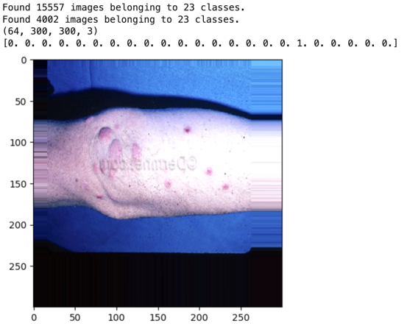
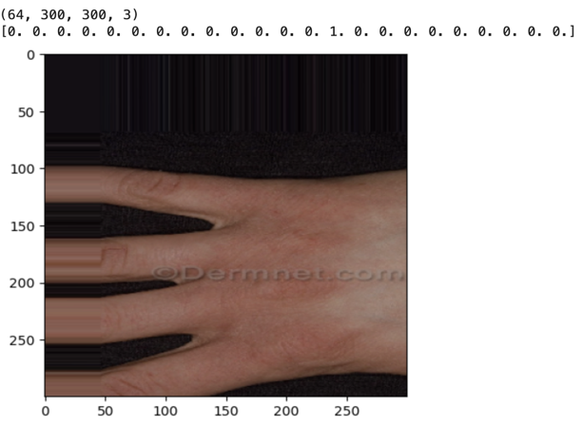
Images being resized to 300x300 pixels and normalized for consistency

Slide 11
IMPLEMENTATION STAGE 2- MODEL DEVELOPMENT
Here we have created 2 models , A CNN model for detecting and analyzing the images and other NLP to understand and handle the text queries from user.
Image Classification Model
CNN using InceptionV3
Fine-tuned with custom layers for skin disease detection
Used Adam optimizer to adjust learning rates automatically
Natural Language Processing (NLP) Model
Created DialoGPT-medium from Hugging Face for handling text-based queries.
Cohere API for generating medication suggestions

Slide 12
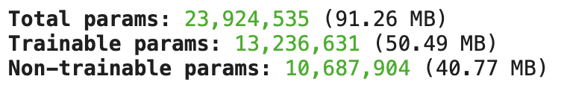



Slide 13
IMPLEMENTATION STAGE 3- SYSTEM INTEGRATION
In this stage, all the system is integrated in a manner to make user inputs to become actionable outcomes.
Integration Frameworks
Backend: Flask - Manages API requests and system logic.
User Interface: Gradio - Allows users to input images and text easily
Image Classification: TensorFlow - Runs the trained model for skin disease detection.
NLP Integration: Hugging Face Transformers - Provides conversational AI and medication suggestions.
Real-Time Alerts: Twilio API for critical condition notifications.

Slide 14
SYSTEM FLOW
Upload skin image
Model inference
Result display with medication advise
Image preprocessing
Notification of severe cases

Slide 15
IMPLEMENTATION STAGE 4 – MODEL EVALUATION
Here the model's strengths and weaknesses are thoroughly assessed, in order to identify key issues like data imbalance etc. which thereby indicating the need for future improvements in a reliable skin disease detection system.
Model Performance Analysis
Training accuracy: 79.54%
Validation accuracy : 56.15%
F1-scores for different skin conditions were computed.
Confusion matrix is used to analyze misclassifications and identified patterns

Slide 16
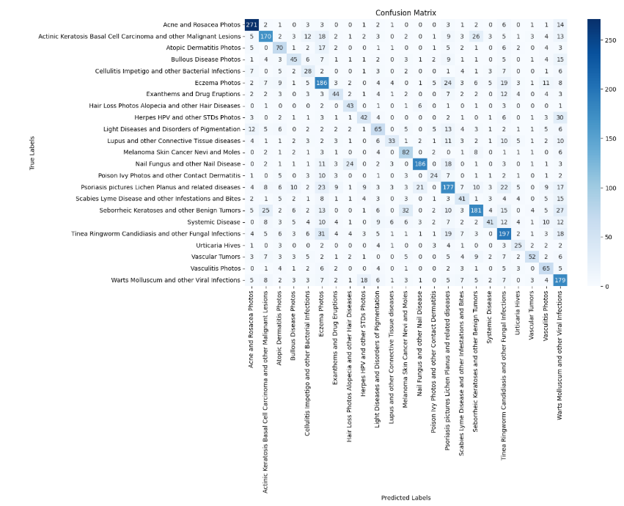
Confusion matrix

Slide 17
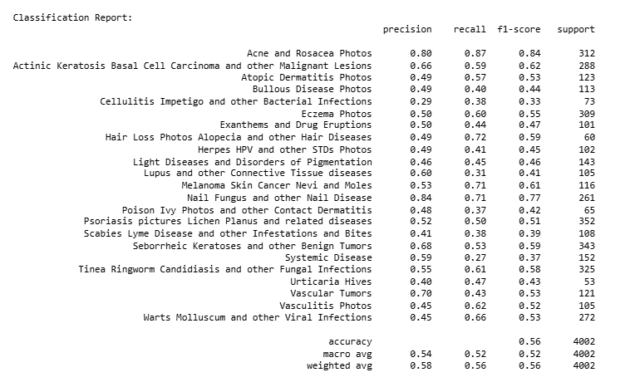
Classification report

Slide 18
IMPLEMENTATION STAGE 5- DEPLOYMENT
The final deployment of the project is done in this stage to see how it works and to understand future improvements.
Deployment Process
Flask-based API is used fir communication between models and UI
Models are hosted with secure ngrok tunneling for real-time accessibility
Models integrated using Hugging Face and TensorFlow libraries

Slide 19
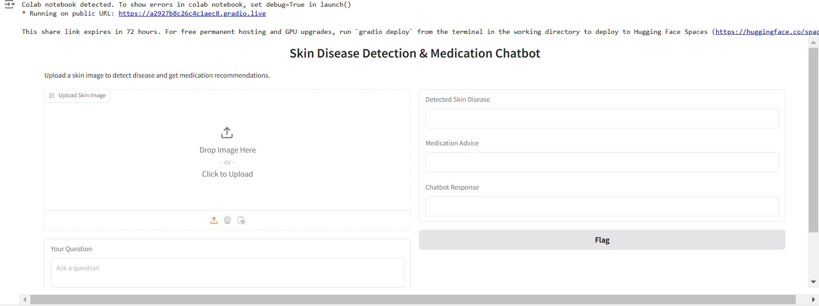
Final launched interface for skin disease detection and medication recommendations.

Slide 20
KEY FINDINGS
we have achieved a system that accurately classifies common skin diseases and provided medication recommendations using CNN and DialoGPT.

Slide 21
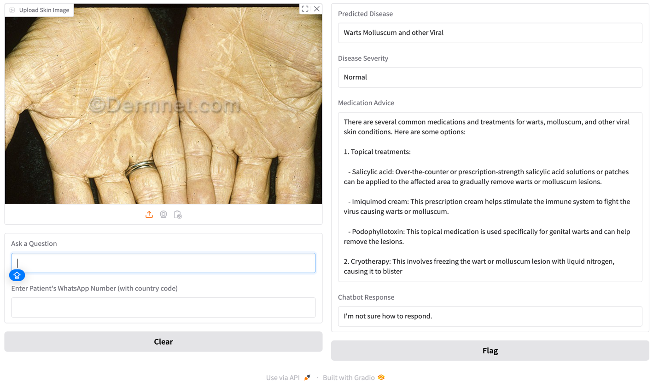

Slide 22
CONCLUSION
Successfully developed an AI-driven system
Improved and automated accessibility to health care
Delivered a platform which is scalable and easy to use
Given a platform that can save time, money and energy !

Slide 23
REFEERNCES
Zhang, J., Zhong, F., He, K., Ji, M., Li, S., & Li, C. (2023). Recent Advancements and Perspectives in the diagnosis of skin diseases using machine learning and deep Learning: a review. Diagnostics, 13(23), 3506. https://doi.org/10.3390/diagnostics13233506
ALEnezi, N. S. A. (2019). A method of skin disease detection using image processing and machine learning. Procedia Computer Science, 163, 85–92. https://doi.org/10.1016/j.procs.2019.12.090
Pathak, C., & Ansari, N. (2023). Chatbot-based Disease Prediction and Treatment Recommendation using AI. K.J. Somaiya Institute of Engineering and IT.
Esteva, A., Kuprel, B., Novoa, R. A., Ko, J., Swetter, S. M., Blau, H. M., & Thrun, S. (2017). Dermatologist-level Classification of Skin Cancer with Deep Neural Networks. Nature, 542(7639), 115–118. https://doi.org/10.1038/nature21056
Tschandl, P., Rinner, C., Apalla, Z., Argenziano, G., Codella, N., Halpern, A., Janda, M., Lallas, A., Longo, C., Malvehy, J., Paoli, J., Puig, S., Rosendahl, C., Soyer, H. P., Zalaudek, I., & Kittler, H. (2020). Human–computer collaboration for skin cancer recognition. Nature Medicine, 26(8), 1229–1234. https://doi.org/10.1038/s41591-020-0942-0

Slide 24
6. Brinker, T. J., Hekler, A., Enk, A. H., Berking, C., Haferkamp, S., Hauschild, A., Weichenthal, M., Klode, J., Schadendorf, D., Holland-Letz, T., von Kalle, C., Fröhling, S., Schilling, B., & Utikal, J. S. (2019). Deep neural networks are superior to dermatologists in melanoma image classification. European Journal of Cancer, 119, 11–17. https://doi.org/10.1016/j.ejca.2019.05.023
7. Kumar, D., Singh, M., & Manish Kushwaha. (2022). Kumar et al., 2021 @ IJA - Nutrient content, uptake and NUE of oats (2). Indian Journal of Agronomy, 66((4)), 466–473 Dec (2021). https://www.researchgate.net/publication/359025271_Kumar_et_al_2021_IJA_-_Nutrient_content_uptake_and_NUE_of_oats_2

Slide 25
LINKS
Dataset: DermNet. (2024, April 22). Images A-Z | DermNet. DermNet®. https://dermnetnz.org/images
Github Repository Link: https://github.com/YeswanthReddychereddy/AI-Driven-NLP-Chatbot-for-Skin-Disease-Diagnosis-and-Medication-recommendations

Slide 26


